Slide 1
HEAL-SL: Excess Mortality During COVID-19 (Bo City, Sierra Leone)
Ahmed Osman, Dickson Kargbo, Faith Bangura, Abubakkar Bah, Ezekiel Rowland, Rashid Ansumana on behalf of the HEAL-SL Team
Ministry of Health and Sanitation
Njala University
University of Toronto
Supported by the Bill and Melinda Gates Foundation and CIHR, Canada

Slide 2
Background
Evidence of high SARS-CoV-2 seroprevalence in other urban African centres
Lower than expected mortality, and lower than expected hospitalizations due to COVID across most of the continent
Possibility that deaths due to COVID were not detected due to home deaths and low registration
Excess mortality in 2020 and 2021 can provide insights

Slide 3
Viral waves/strains of COVID-19 cases in Sierra Leone and HEAL-SL sampling periods
HEAL-SL 2 (first part)
HEAL-SL 2
HEAL-SL 1
~ Delta
~ Alpha
Original strain
~ Omicron
80% of ~7700 reported cases are in Western Area Urban (Freetown) and Rural, and incoming passengers

Slide 4
Average deaths in peak COVID period in first viral wave (May-Jun 2020), Western Area Urban- no excess seen versus same months in 2018 and 2019 (but other rounds not yet ready)

Slide 5
SARS-2-CoV Serosurvey in urban Bo
HEAL-SL DBS study covered about 4200 adults age 18+ randomly selected from about half of Bo urban areas
Field work was in July-Aug 2021 and repeated in same group in March 2022
224 of 4200 randomly selected for COVID antibody testing
144 retested in March 2022 (117 same person)
High quality chemiluminescence ELISA at Sinai Labs, Toronto
3 antigens- RBD, Spike and Nucleocapsid, Strictest analyses of RBD+ Spike

Slide 6
SARS-CoV-2 prevalence in urban adults
Antigen | N = 224 N=144 (117 resampled July-Aug 2021 March 2022 Delta wave post Omicron
RBD positive | 157 (70%) 121 (84%)
Spike positive | 202 (90%) 142 (99%)
RBD + Spike positive | 155 (69%) 121 (84%)
43 Pre-Pandemic samples (2019) tested: RBD +Spike positive: 0 (0%)
Of 77 Delta wave samples tested, 37 (48%) had significant neutralizing response
Age pattern- Spike positive (Delta wave), n=224
Age group Prevalence
18-24 93% (69)
25-49 90% (93)
50-70 87% (41)

Slide 7
Did COVID kill? Method: examine various mortality data sources
4 Research Assistants visited every burial ground in Bo City, and collected from tombstones, villagers, and burial forms:
Age, Sex, and Date of Death
Bo City Cemetery
Additional data from 1-1-7 Call Line and Bo Government Mortuary
Non-fatal Mercy Hospital admissions

Slide 8
Death rate per 100,000 population in two mortality data sources in Bo
Year | 15-24 | 25-49 | 50+
Bo City Cemetery, Total deaths=1877
2019 | 15 | 70 | 120
2020 | 20 | 120 | 212
2021 | 12 | 68 | 141
1-1-7 Reported deaths, Total deaths=3711
2019 | 7 | 41 | 73
2020 | 16 | 63 | 122
2021 | 9 | 42 | 56

Slide 9
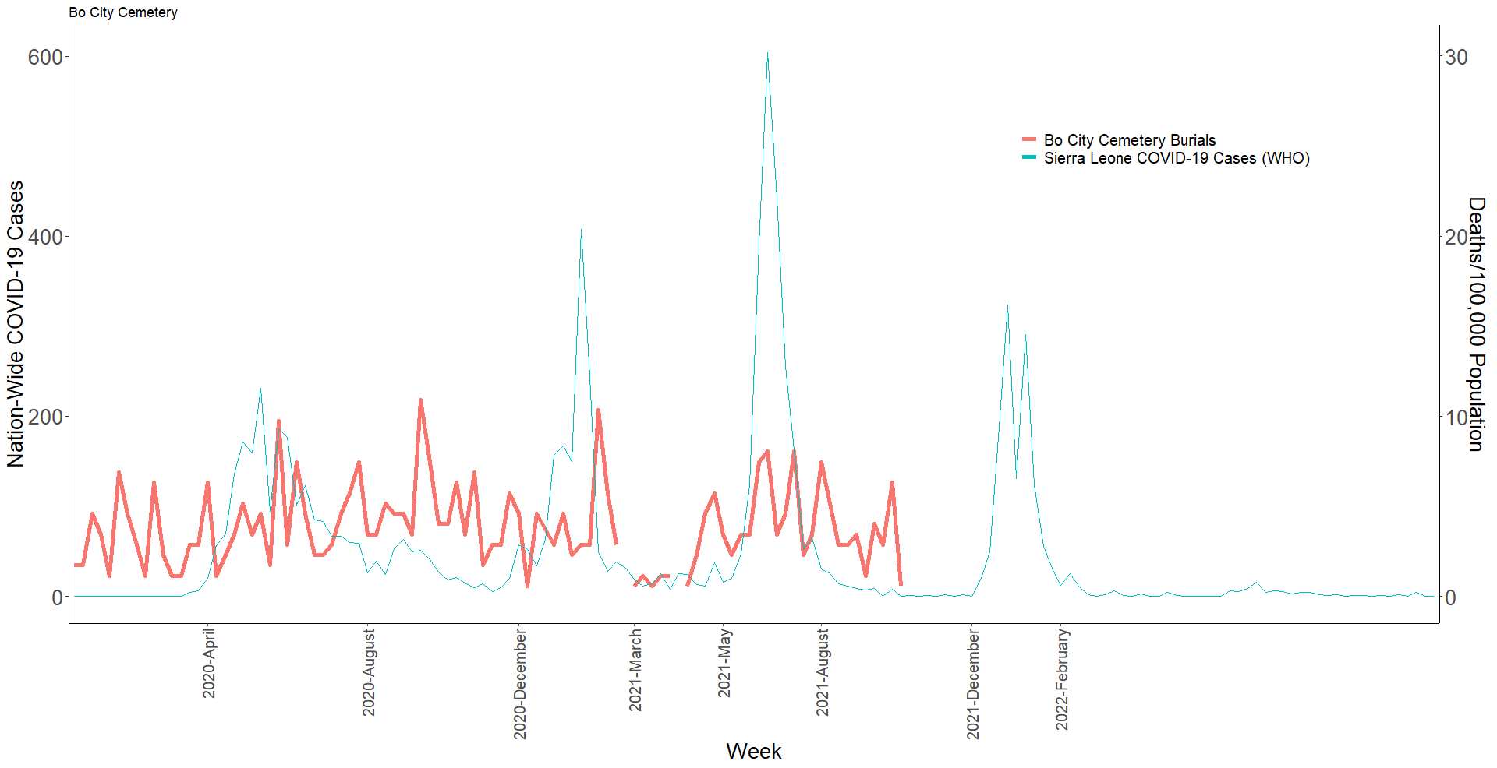
Bo City Cemetery age 50+
Deaths by week 2020-2021
~ Delta
Bo City Cemetery
Sierra Leone COVID Cases (WHO)
~ Alpha
~ Omicron
Original strain

Slide 10
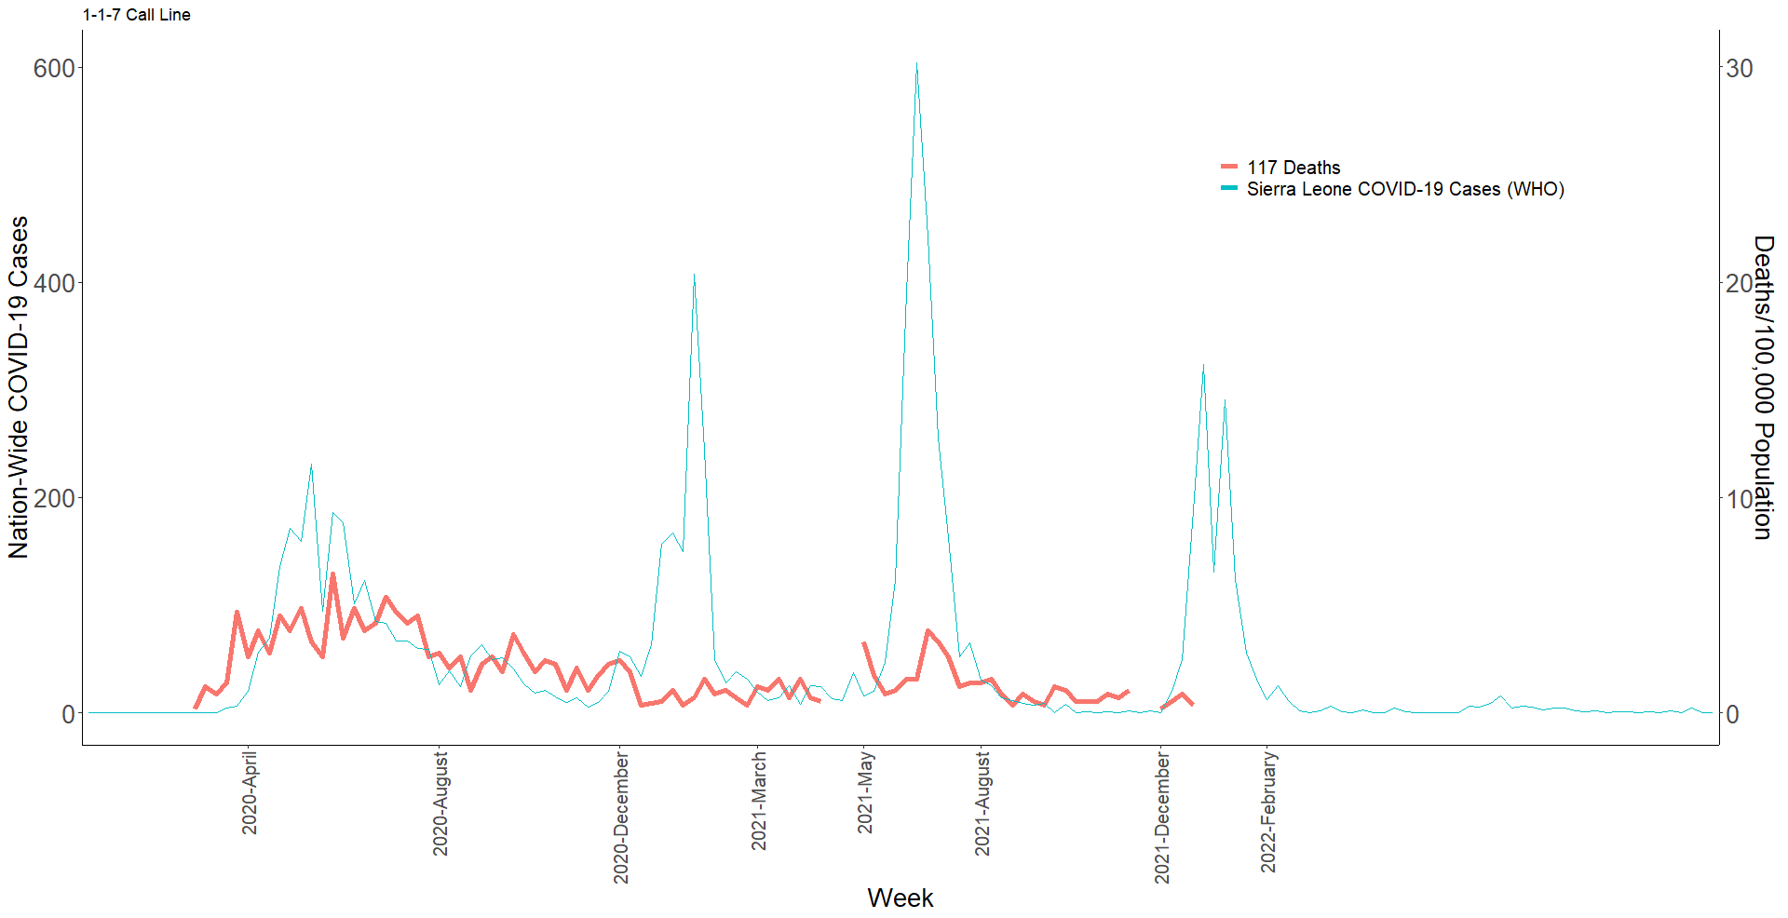
117 Call Line ages 50+
Deaths by week 2020-2021
~ Delta
117 Call Line Deaths
Sierra Leone COVID Cases (WHO)
~ Alpha
~ Omicron
Original strain

Slide 11
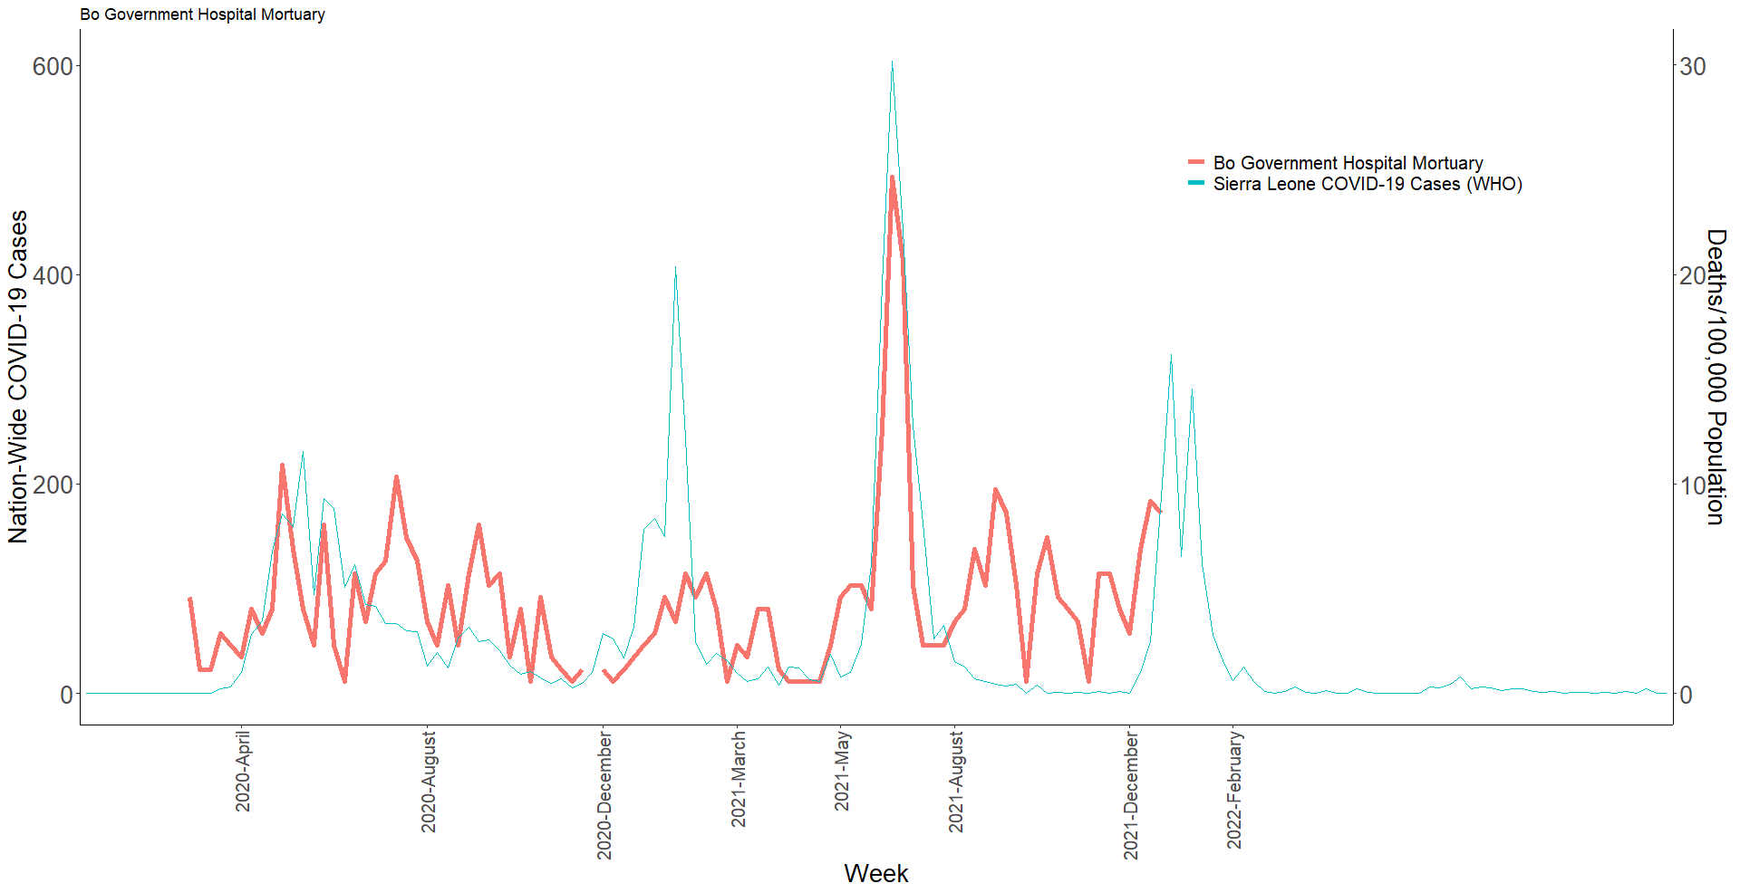
Bo Government Hospital Mortuary ages 50+, deaths by week 2020-21
~ Delta
Mortuary (Bo Govt. Hospital)
Sierra Leone COVID Cases (WHO)
~ Alpha
~ Omicron
Original strain

Slide 12
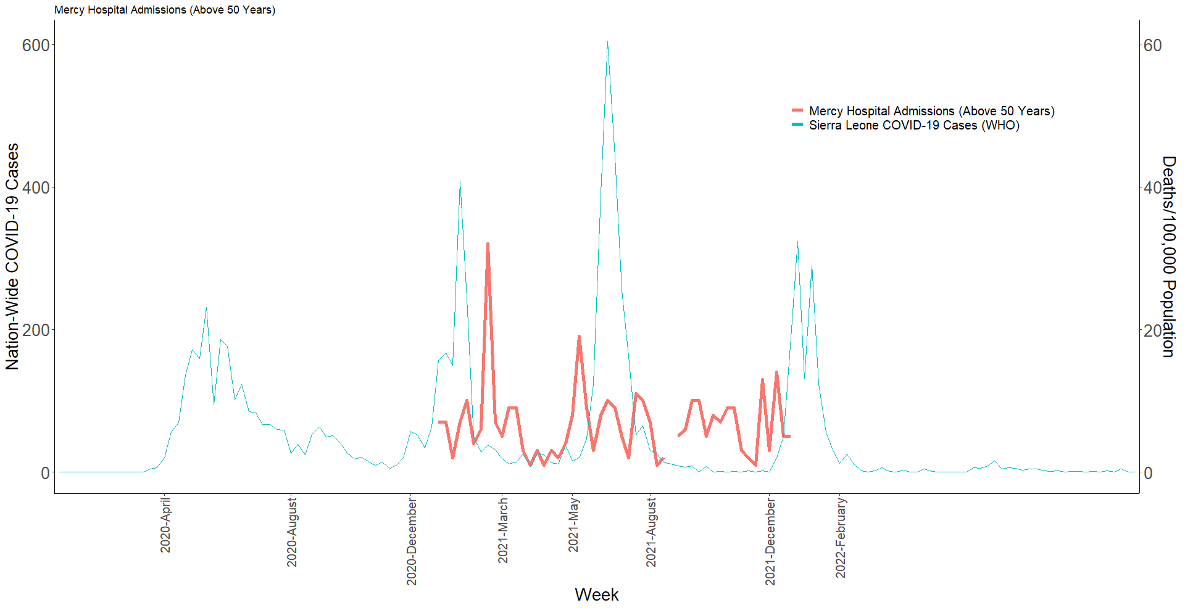
Mercy Hospital Admissions ages 50+ by week, 2020-21
~ Delta
Mercy Hospital Admissions
Sierra Leone COVID Cases (WHO)
~ Alpha
~ Omicron
Original strain

Slide 13
Key points
Increase in number of reported deaths in 2020 above age 50 years
Below age 50 deaths likely NOT COVID, but may reflect other causes or change in reporting
Excess deaths age 50+ coincide with the first wave of SARS-CoV-2 infection in Sierra Leone, but no major excess deaths in subsequent waves
Nationally representative data from HEAL-SL (round 2, covering COVID period) should provide more detailed information

Slide 14
Summary
Sierra Leone had high rates of infection from SARS-CoV-2 in urban areas at all ages, including the elderly (60+)
Low number of excess deaths during peak waves of SARS-CoV-2, except for first wave or Alpha wave in 2020
Little evidence of excess deaths during Delta wave of 2021 or Omicron wave of 2021/2022

